Slide 1
An Investigation into Extending a 3D Cross Section of 4D Geometry and their Effectiveness in Teaching Users to Manipulating This Geometry
Joe Subbiani
Notes:
Welcome to the presentation for my investigation into the effectiveness of representing 4D geometry through extensions to the 3D cross section.
This project aims to evaluate the effectiveness of 3 extensions to viewing the 3D cross section of 4D space.
In order to evaluate their effectiveness, each representation was tested by novice users to test how clearly the representation can describe the surface of the object, convey rotations of an object, and assist in the manipulation of an object.

Slide 2
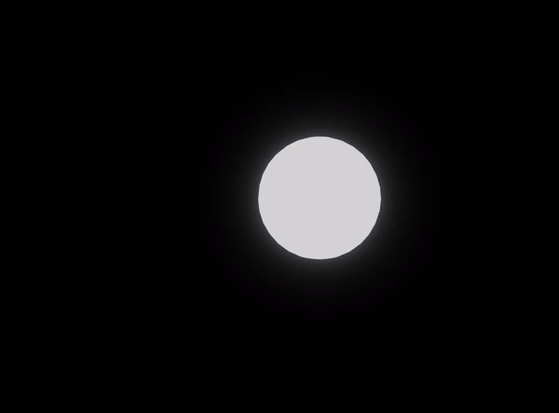
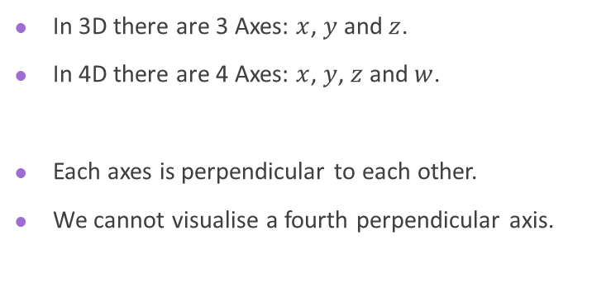
What is the 4th Dimension Structure
In 3D there are 3 Axes: $x$, $y$ and $z$.
In 4D there are 4 Axes: $x$, $y$, $z$ and $w$.
Each axes is perpendicular to each other.
We cannot visualise a fourth perpendicular axis.
Notes:
In 3D Euclidian space there are 3 axes: x, y and z.
In 4D there is a fourth perpendicular axis labeled w
Don’t try visualize this, its easier just to abstract it to a 3D to 2D example

Slide 3
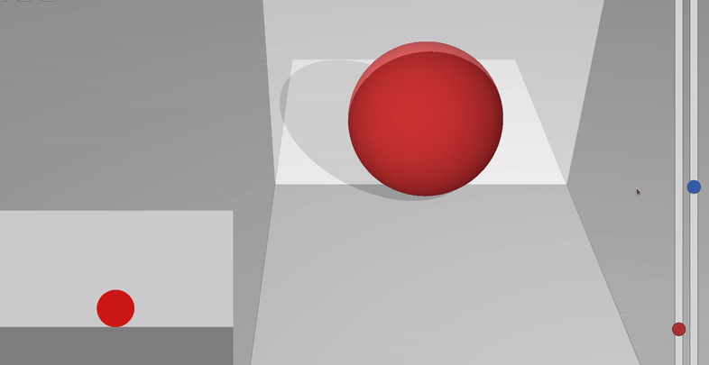
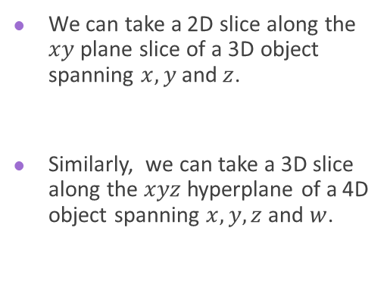
Taking A 3D Cross Section
How to view the 4th Dimension
We can take a 2D slice along the $xy$ plane slice of a 3D object spanning $x,y$ and $z$.
Similarly, we can take a 3D slice along the $xyz$ hyperplane of a 4D object spanning $x,y,z$ and $w$.
Notes:
Taking a 3D cross section of 4D space is similar to taking a 2D cross section of 3D space
Here a cross section spanning the xy plane shows a slice of the sphere. You can see the cross section changes as you pass the object through the slice.
A 3D cross section would take a slice along the w axis, spanning x y and z.

Slide 4
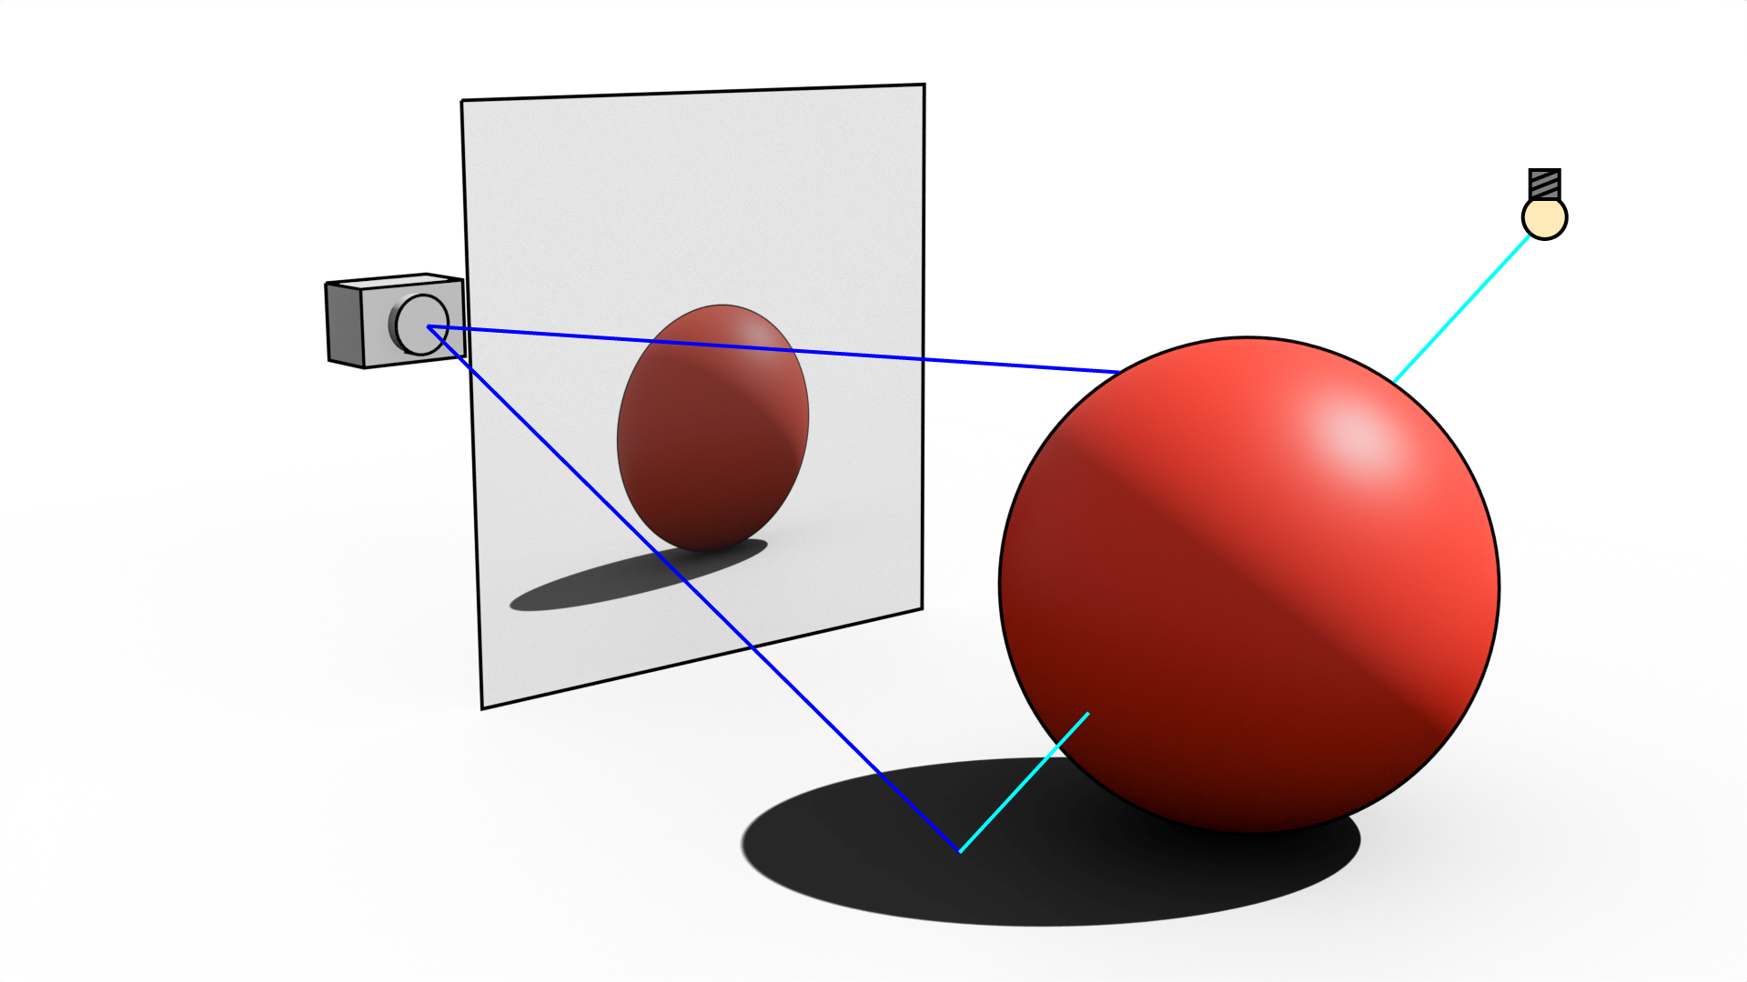
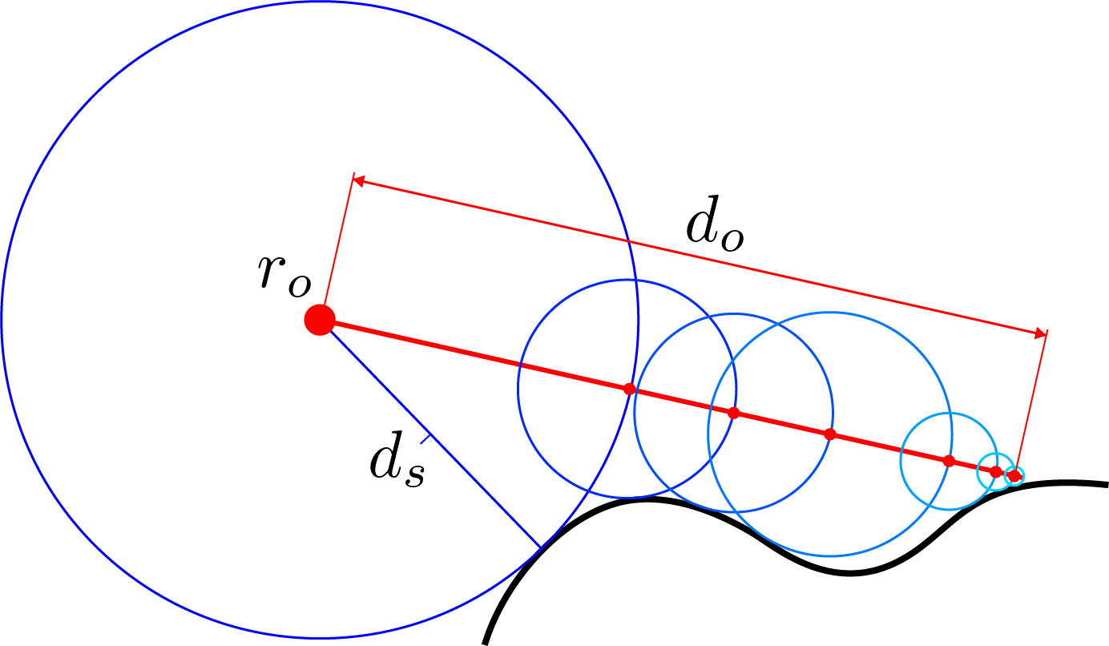
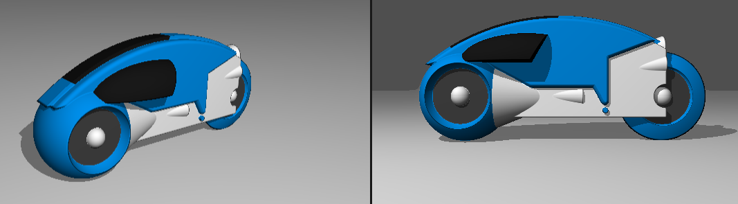
Ray Marching
Building 4D Shapes
Fun Fact: The original Tron used Ray Marching!
Notes:
Rather than traditional polygon meshes, I used ray marching to build the 4D shapes.
Not only would it be more time consuming to develop several 4D meshes, I would have to implement an algorithm to take the cross section.
Ray marching provides a platform to render several basic primitive objects as mathematical expressions, rather than vertex by vertex, face by face.
Moreover, ray marching over a 3D space automatically takes the 3D cross section of the 4D object, as the ray origin and hit position lie within the same plane along the w axis.
So what is ray marching?
Ray marching is the process of taking the distance to the nearest surface, and marching forward to work out how to colour a pixel.
Rather than describing a shape through a mesh, shapes are defined through mathematical expression, for example, the sphere is defined as a radius from a point.
This makes it very easy to build shapes that would be very time consuming to make in 4D.
Once more, ray marching allows for efficient rendering of smooth surfaces, without the need for hundreds of polygons.

Slide 5
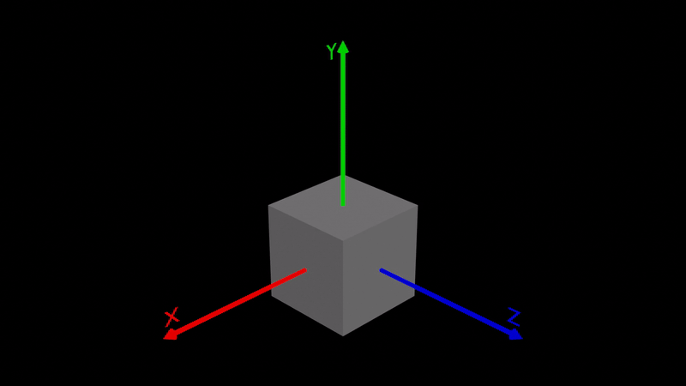
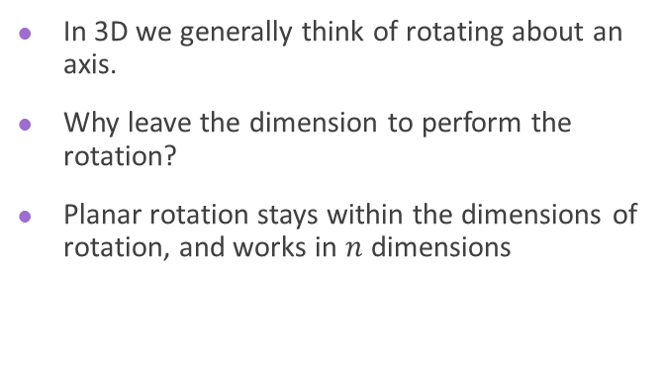
Rotating About a Plane
4D Rotation
In 3D we generally think of rotating about an axis.
Why leave the dimension to perform the rotation?
Planar rotation stays within the dimensions of rotation, and works in $n$ dimensions
Notes:
So how do we manipulate these shapes?
To understand 4D rotation, we need to reimagine the definition of a rotation.
Rather than rotating about an axis, we rotate about a plane.
Imagine a rotating 2D square. It does not make sense to define the rotation as “about the z axis”. This leaves the dimension.
Rather we consider the rotation as one about the x y plane.
Planar rotations are extendable to any number of dimensions, axial rotations do not.

Slide 6
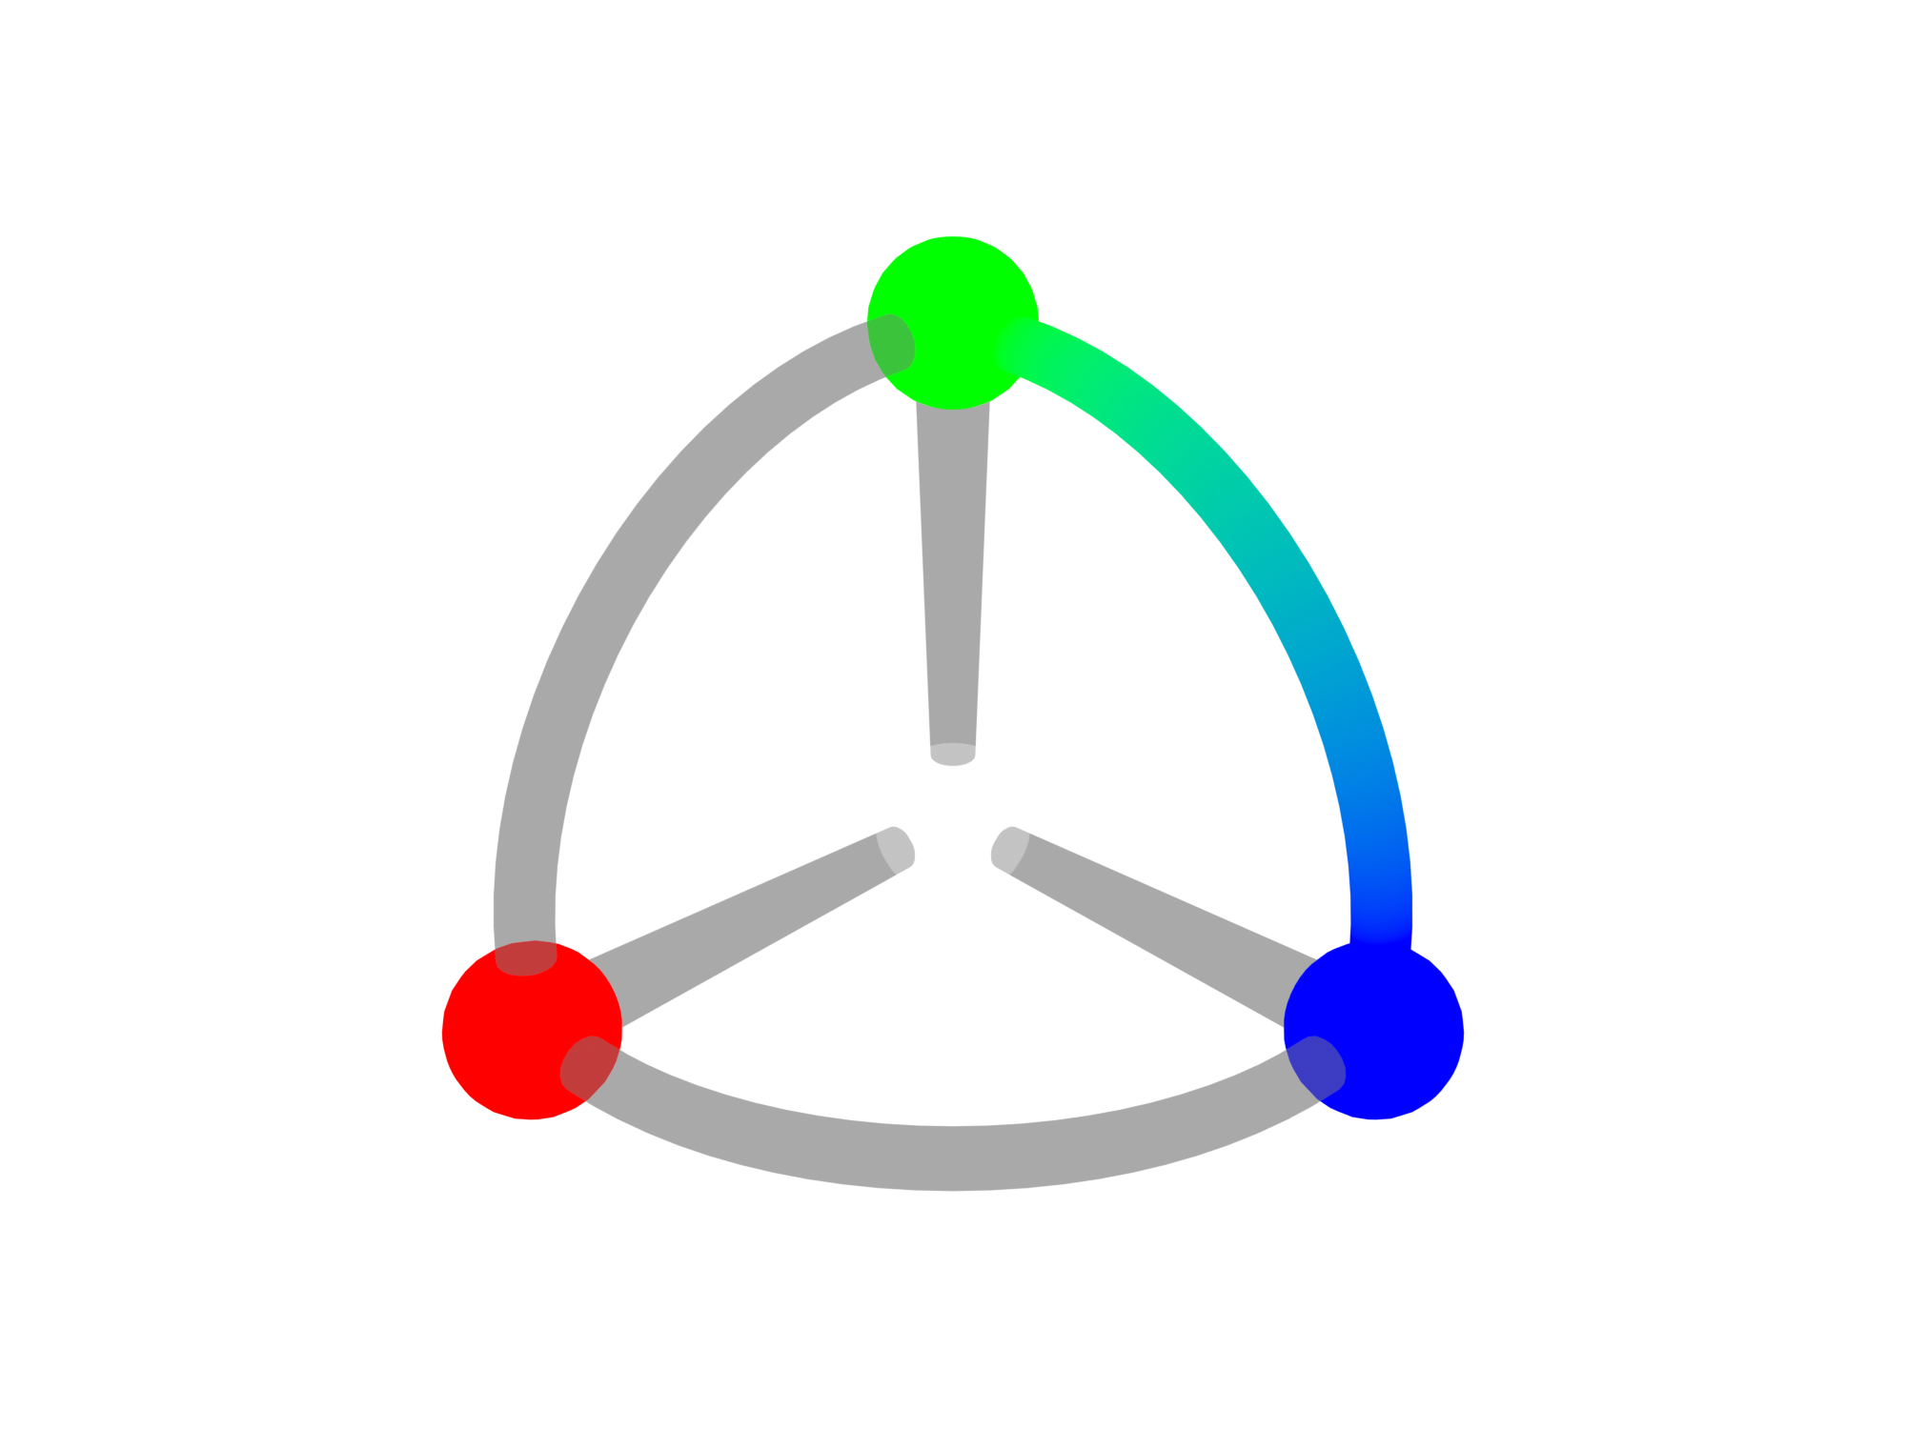
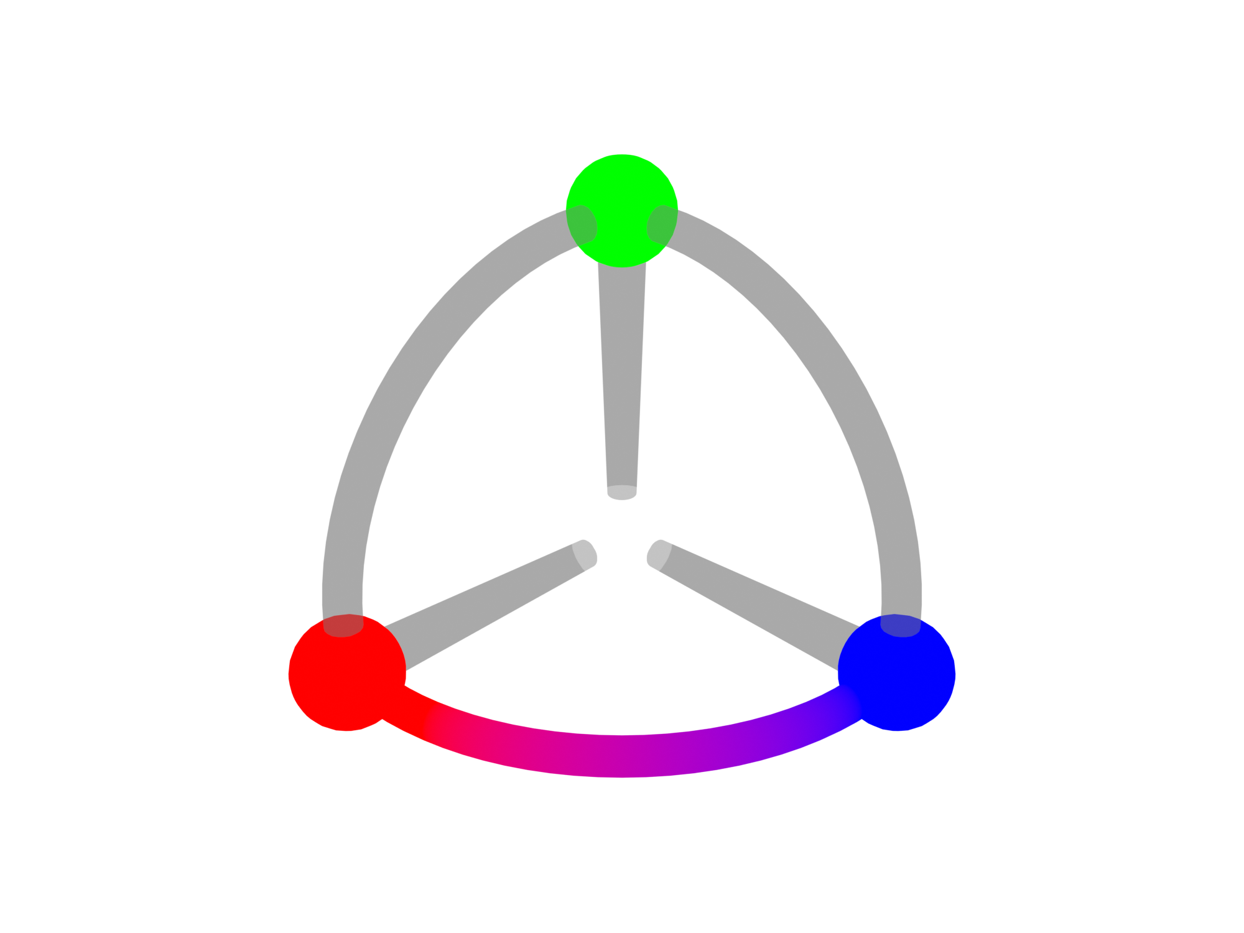
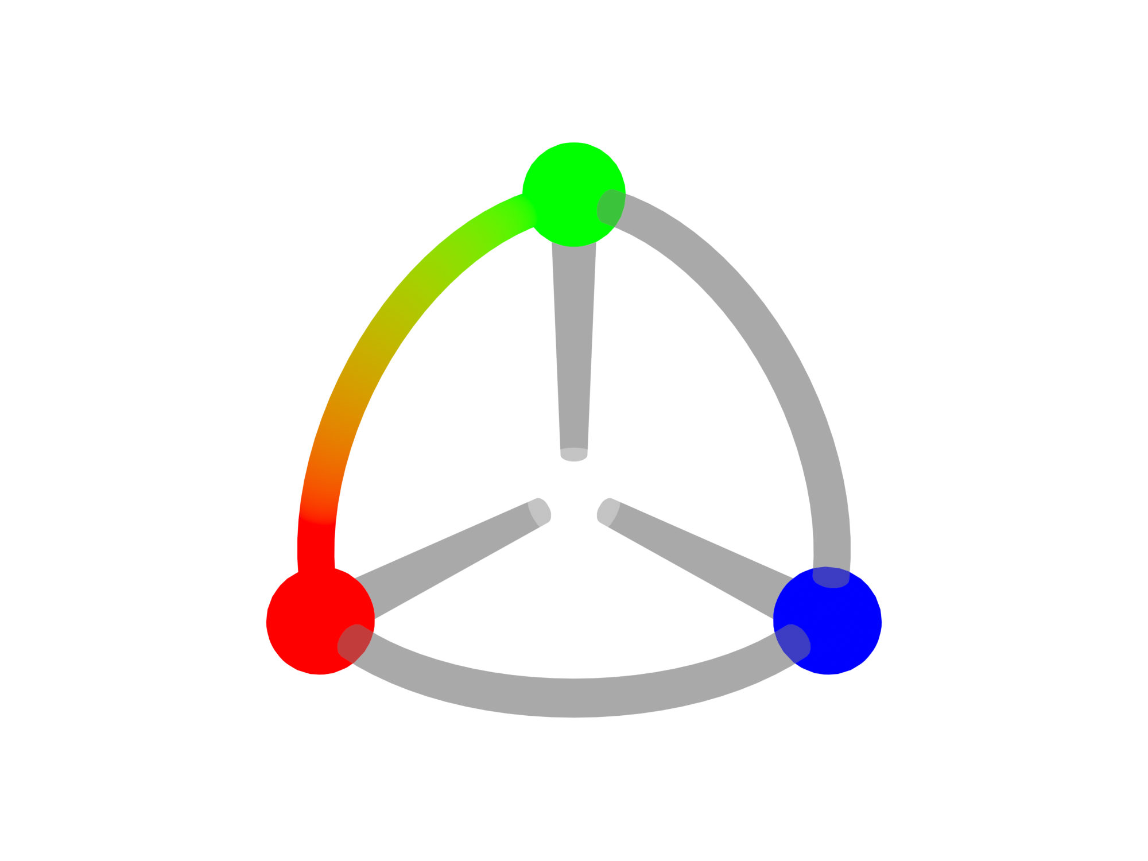
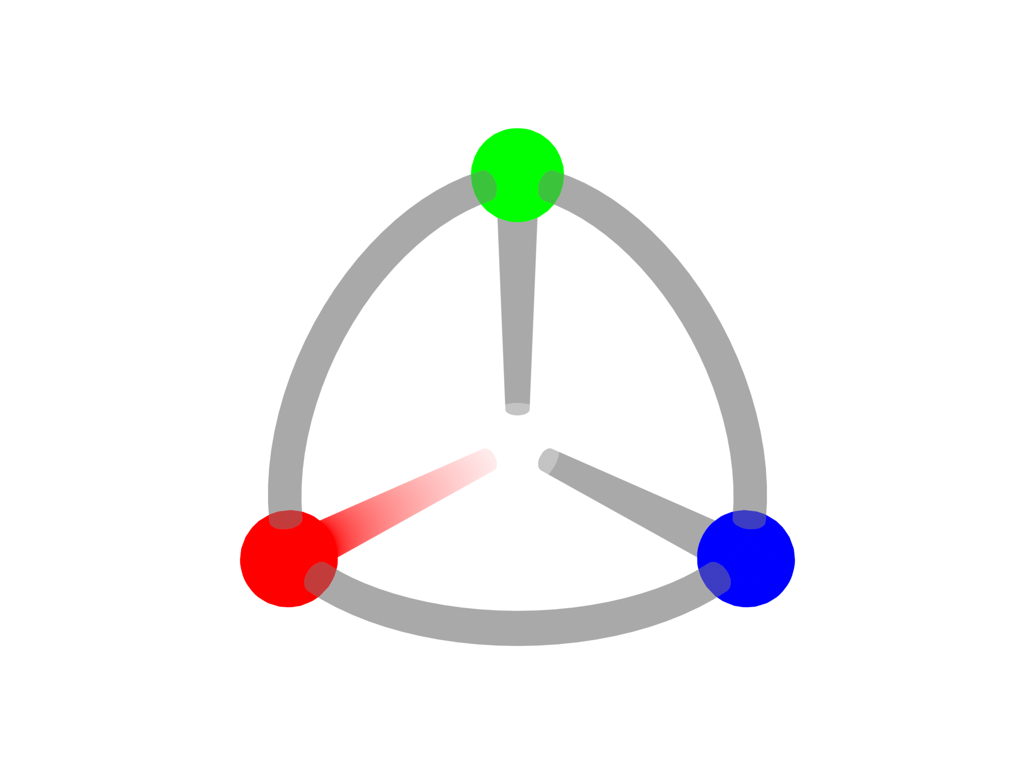
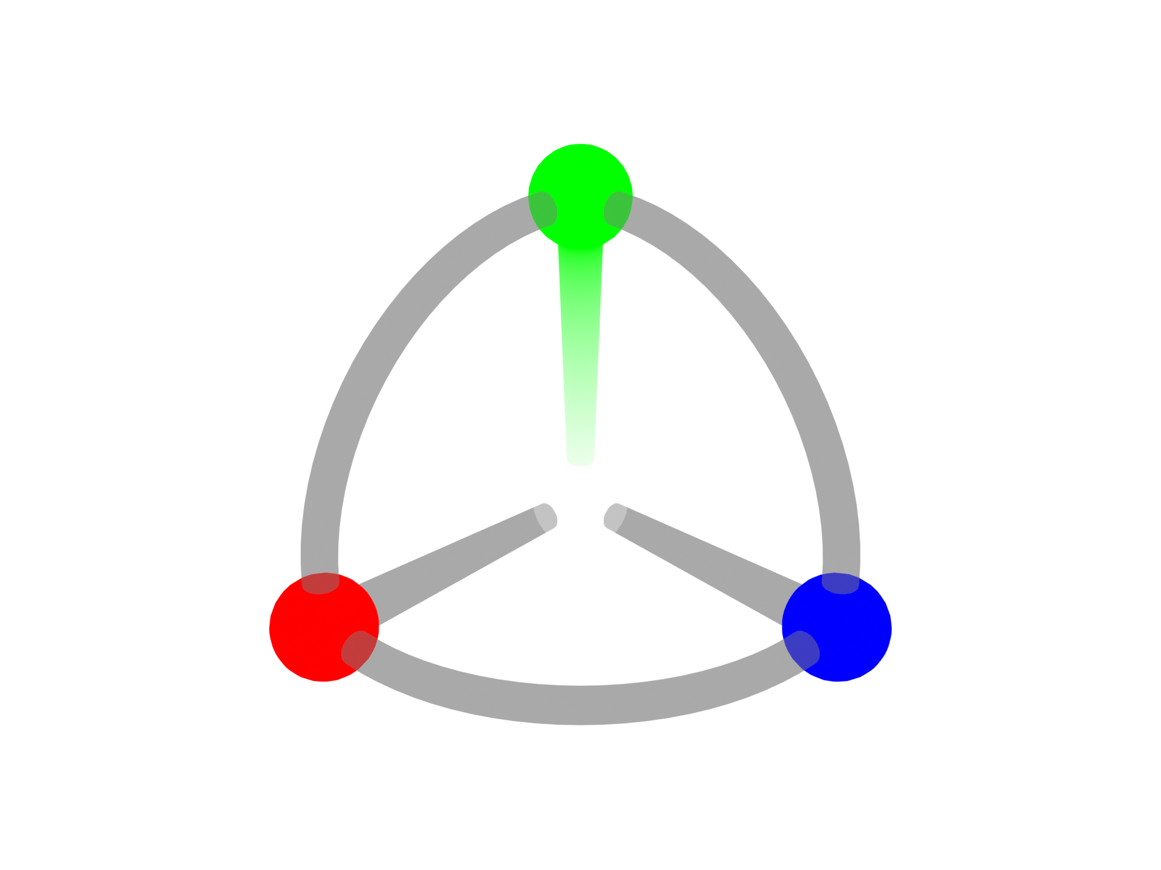
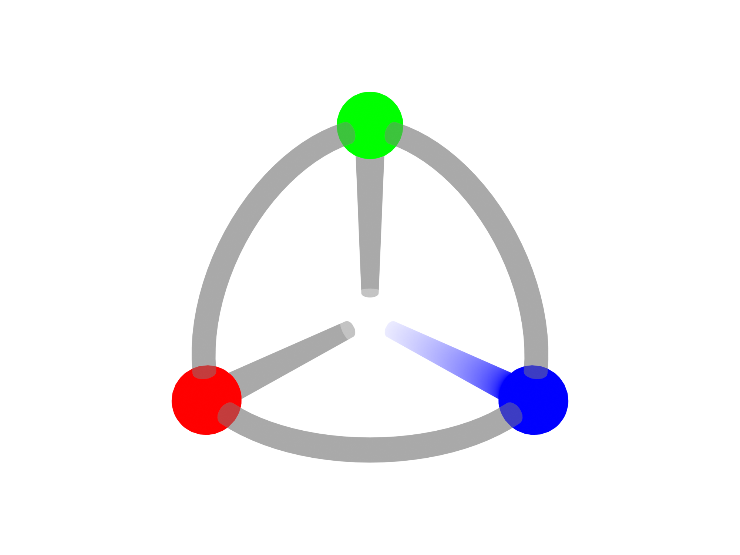
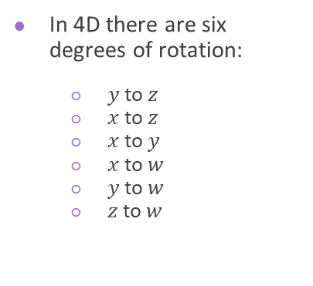
4D Rotation
In 4D there are six degrees of rotation:
$y$ to $z$
$x$ to $z$
$x$ to $y$
$x$ to $w$
$y$ to $w$
$z$ to $w$
Notes:
In 4D, there are 6 degrees of rotation, defined by the 6 possible planes of rotation listed on the slide.

Slide 7
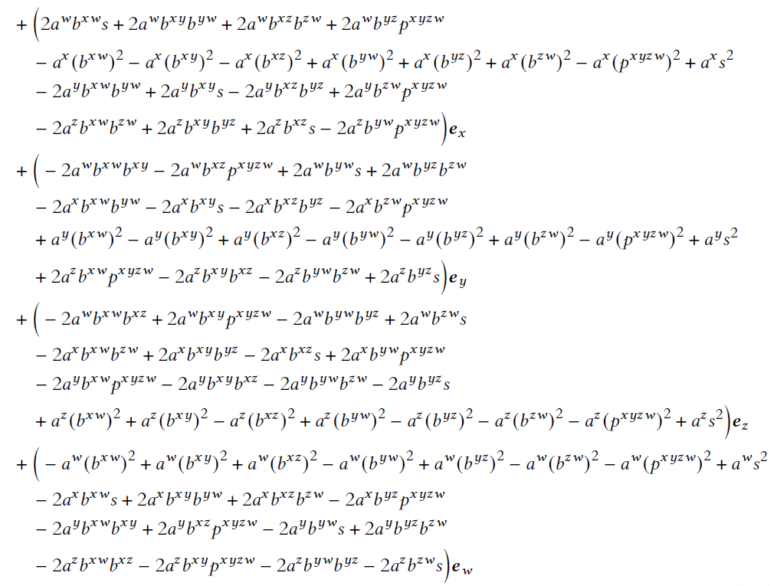
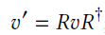
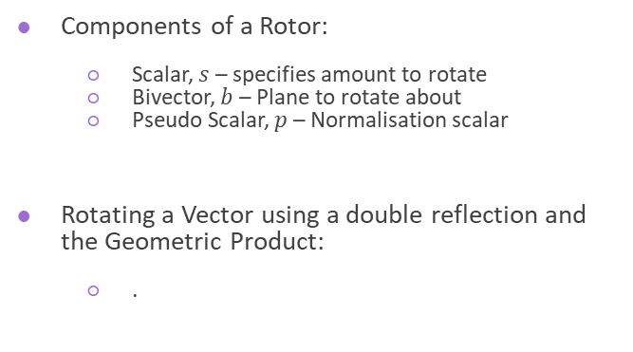
The Rotor
4D Rotation
Components of a Rotor:
Scalar, $s$ – specifies amount to rotate
Bivector, $b$ – Plane to rotate about
Pseudo Scalar, $p$ – Normalisation scalar
Rotating a Vector using a double reflection and the Geometric Product:
.
Notes:
Rotating shapes using familiar euler angles lead to gimbal lock – a non trivial problem to overcome.
Generally, we use quaternions to overcome this.
Quaternions, however are based around axial rotations.
In geometric algebra, there is an entity known as the rotor.
The rotor is very similar to the quaternion, but it considers a rotation about a plane.
A 4D rotor is composed of 3 components,
A scalar which defines the amount of rotation
A bivector which defines the plane to rotate about
A pseudo scalar - a normalisation component in 4D
In code, a bivector is broken down into 6 projections onto each plane of rotation.
A rotation can be accomplished using what is known as the sandwich product of a vector.
The equation for the 4D rotation of a vector using a rotor is shown on the right, and trust me it was not fun to derive.

Slide 8
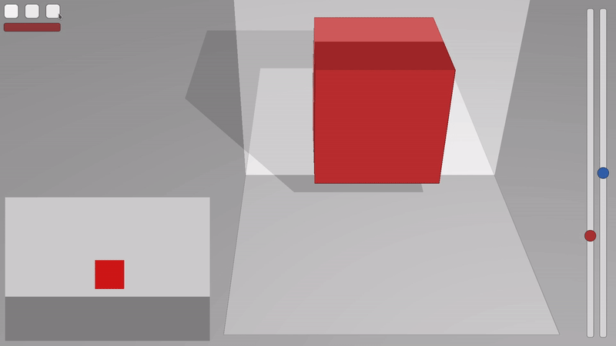
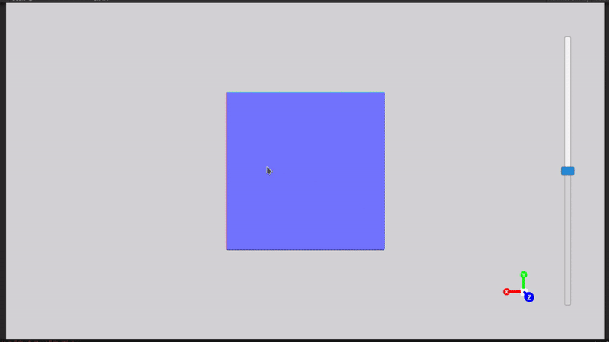

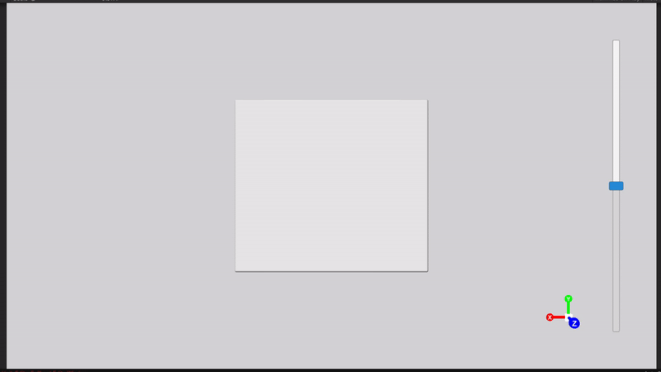
4D Rotation: 2D 3D 4D
2D Cross Section of 3D Object
3D Cross Section of 4D Object
Rotation within dimensions
Rotation outside of dimensions

Slide 9
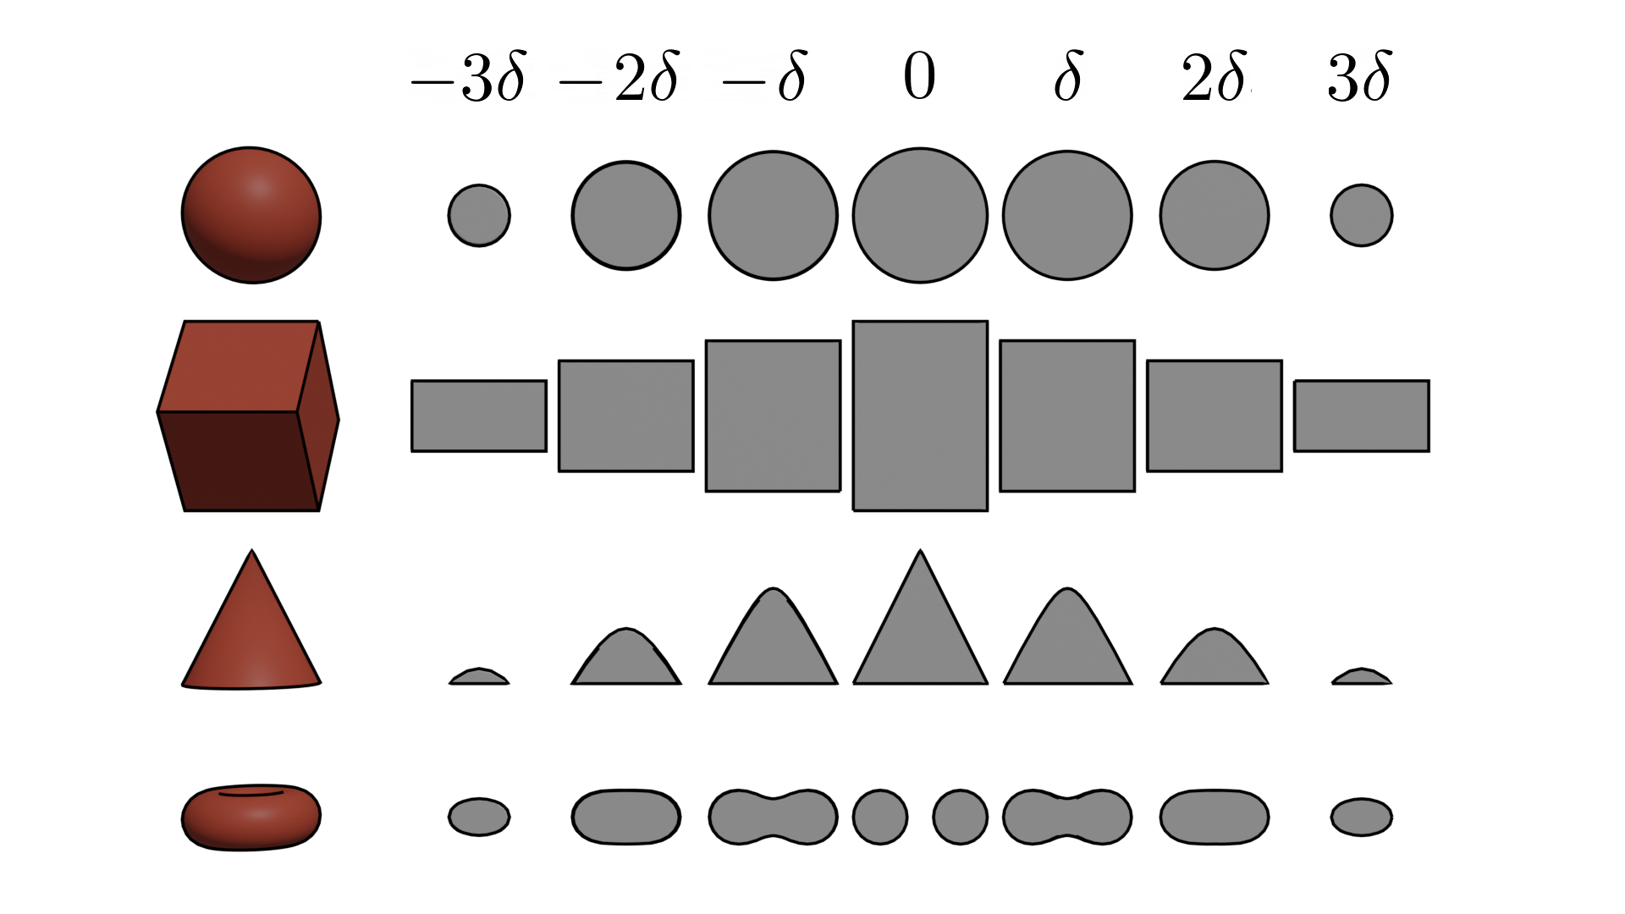
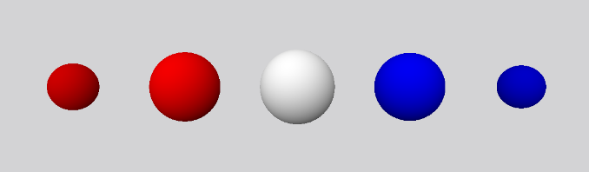
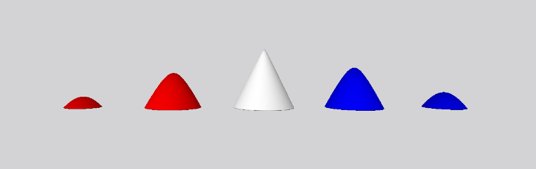
W-Axis “Timeline”
2D cross section of 3D Object $δ=0.15$ 3D cross section of 4D object $δ=0.2$
Extending a Cross Section of a 4D Object

Slide 10
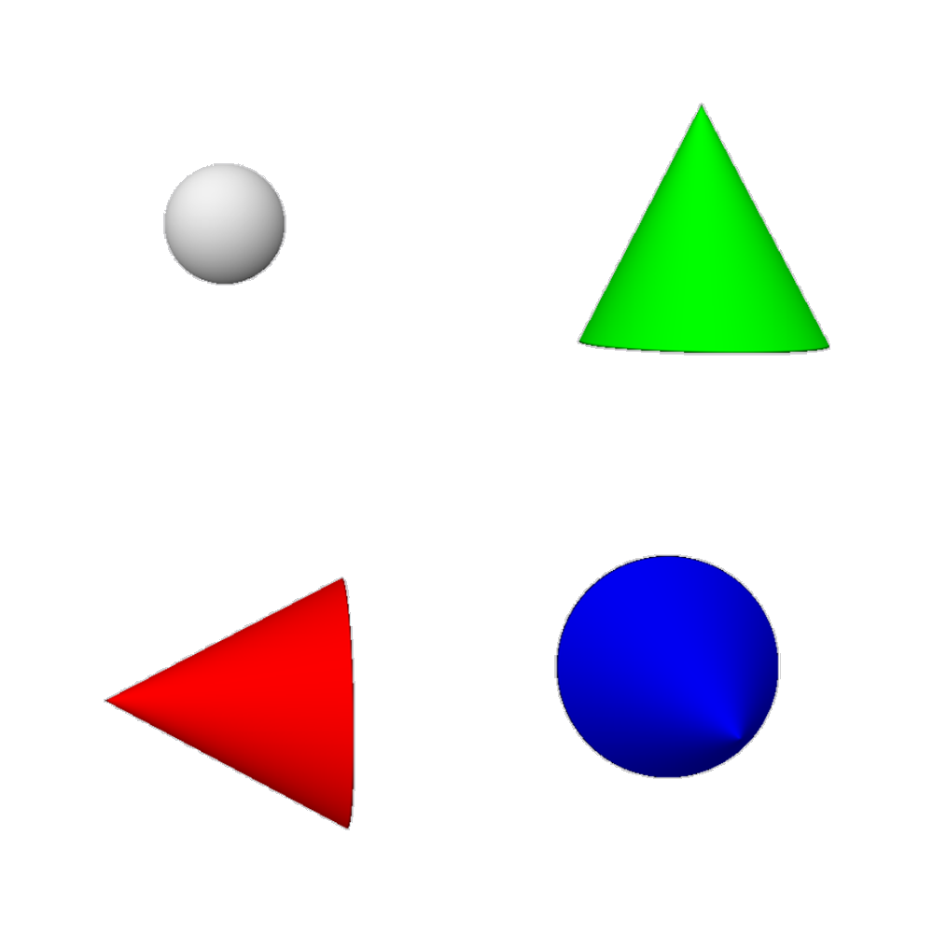
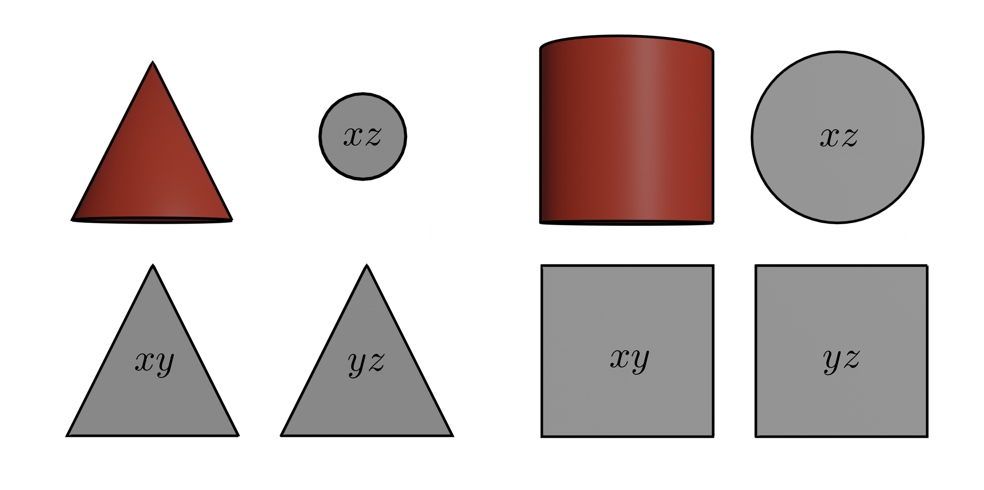
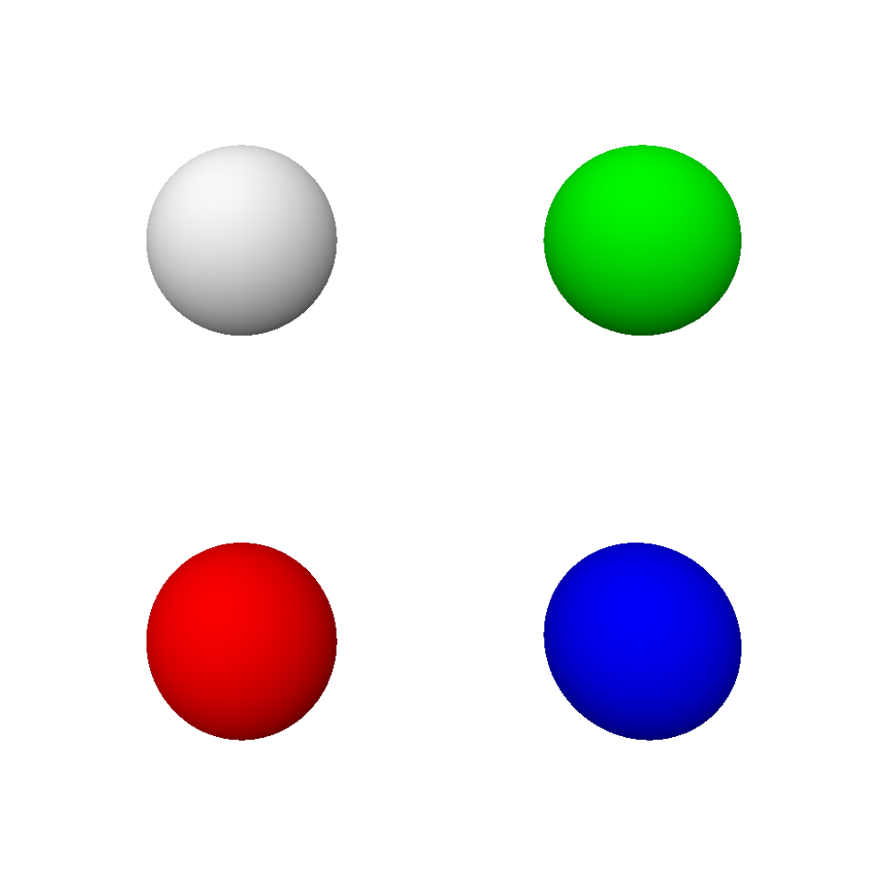
Multi-Rotational Views
Extending a Cross Section of a 4D Object

Slide 11
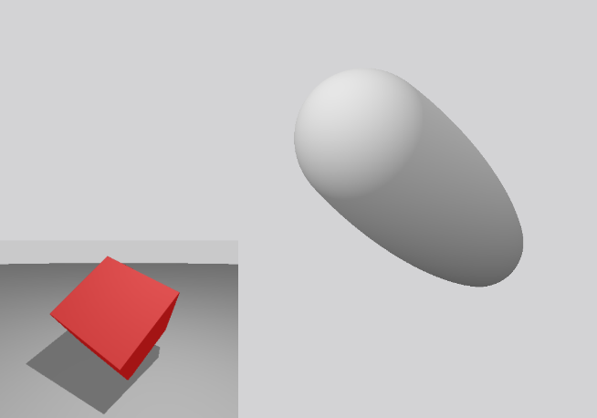
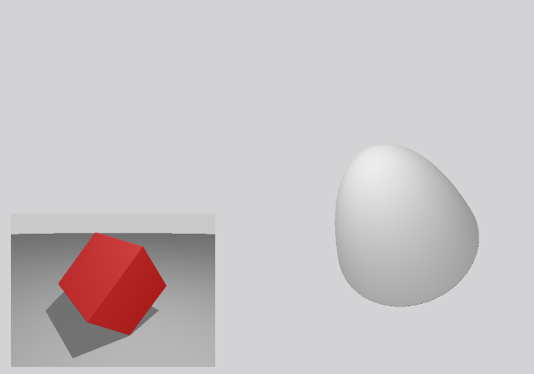
3D Axial Rotations on the 3D Component of a 4D Plane of Rotation
Extending a Cross Section of a 4D Object

Slide 12
Challenges
The Experiment
Challenging – time vs data
May have been too short for users
Notes:
Motivation - purpose

Slide 13
The van Hiele Model of Geometric Thinking
The Experiment
Stages in learning process
Needs people to understand

Slide 14
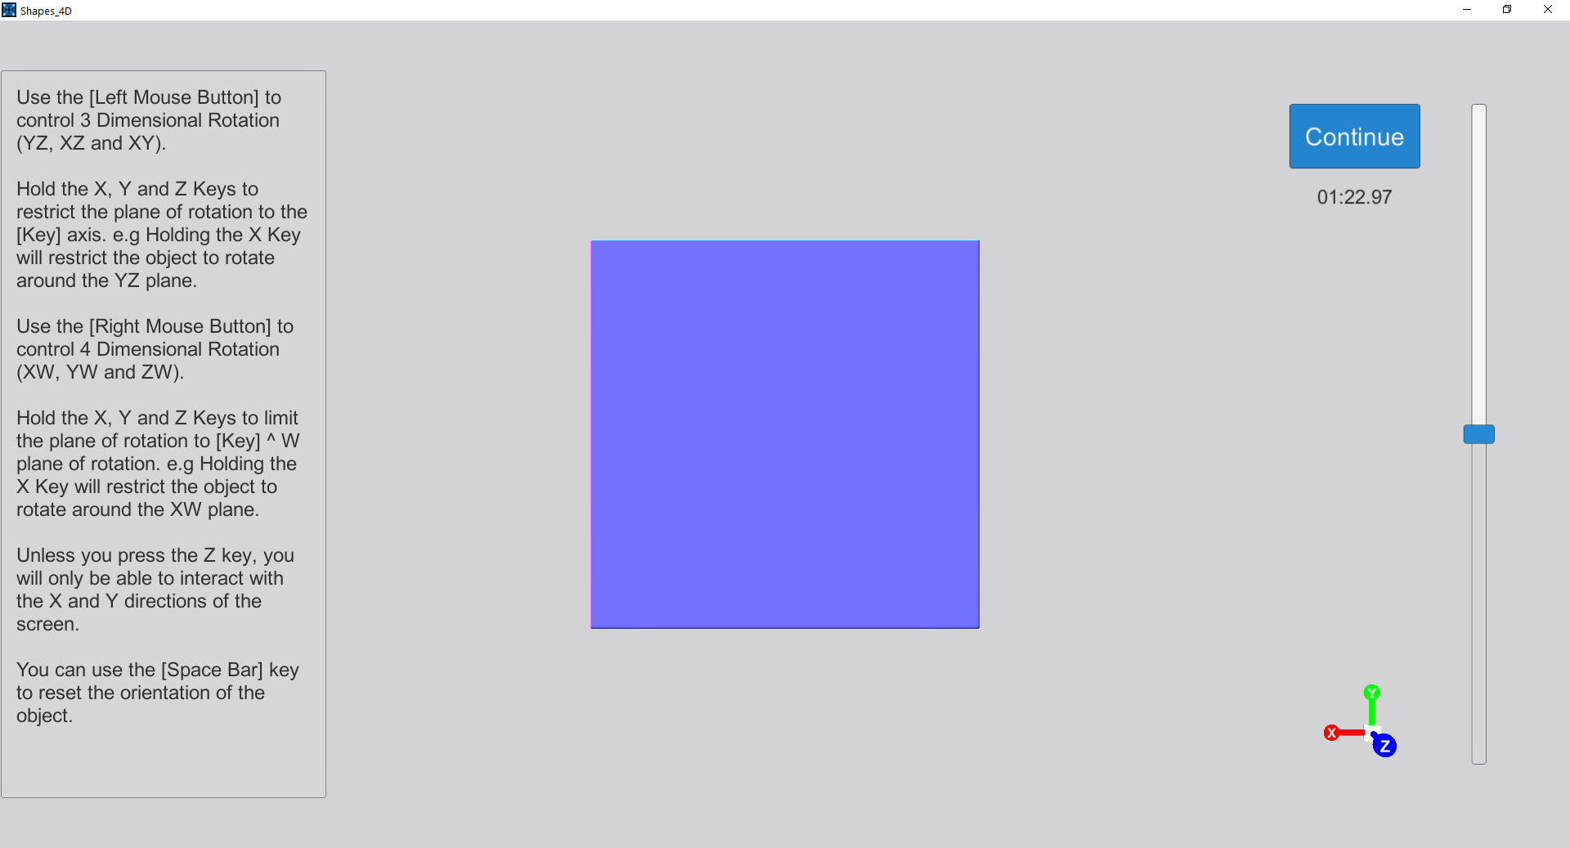
Introduction
The Experiment
Video
Small time to interact
Very much encourage questions

Slide 15
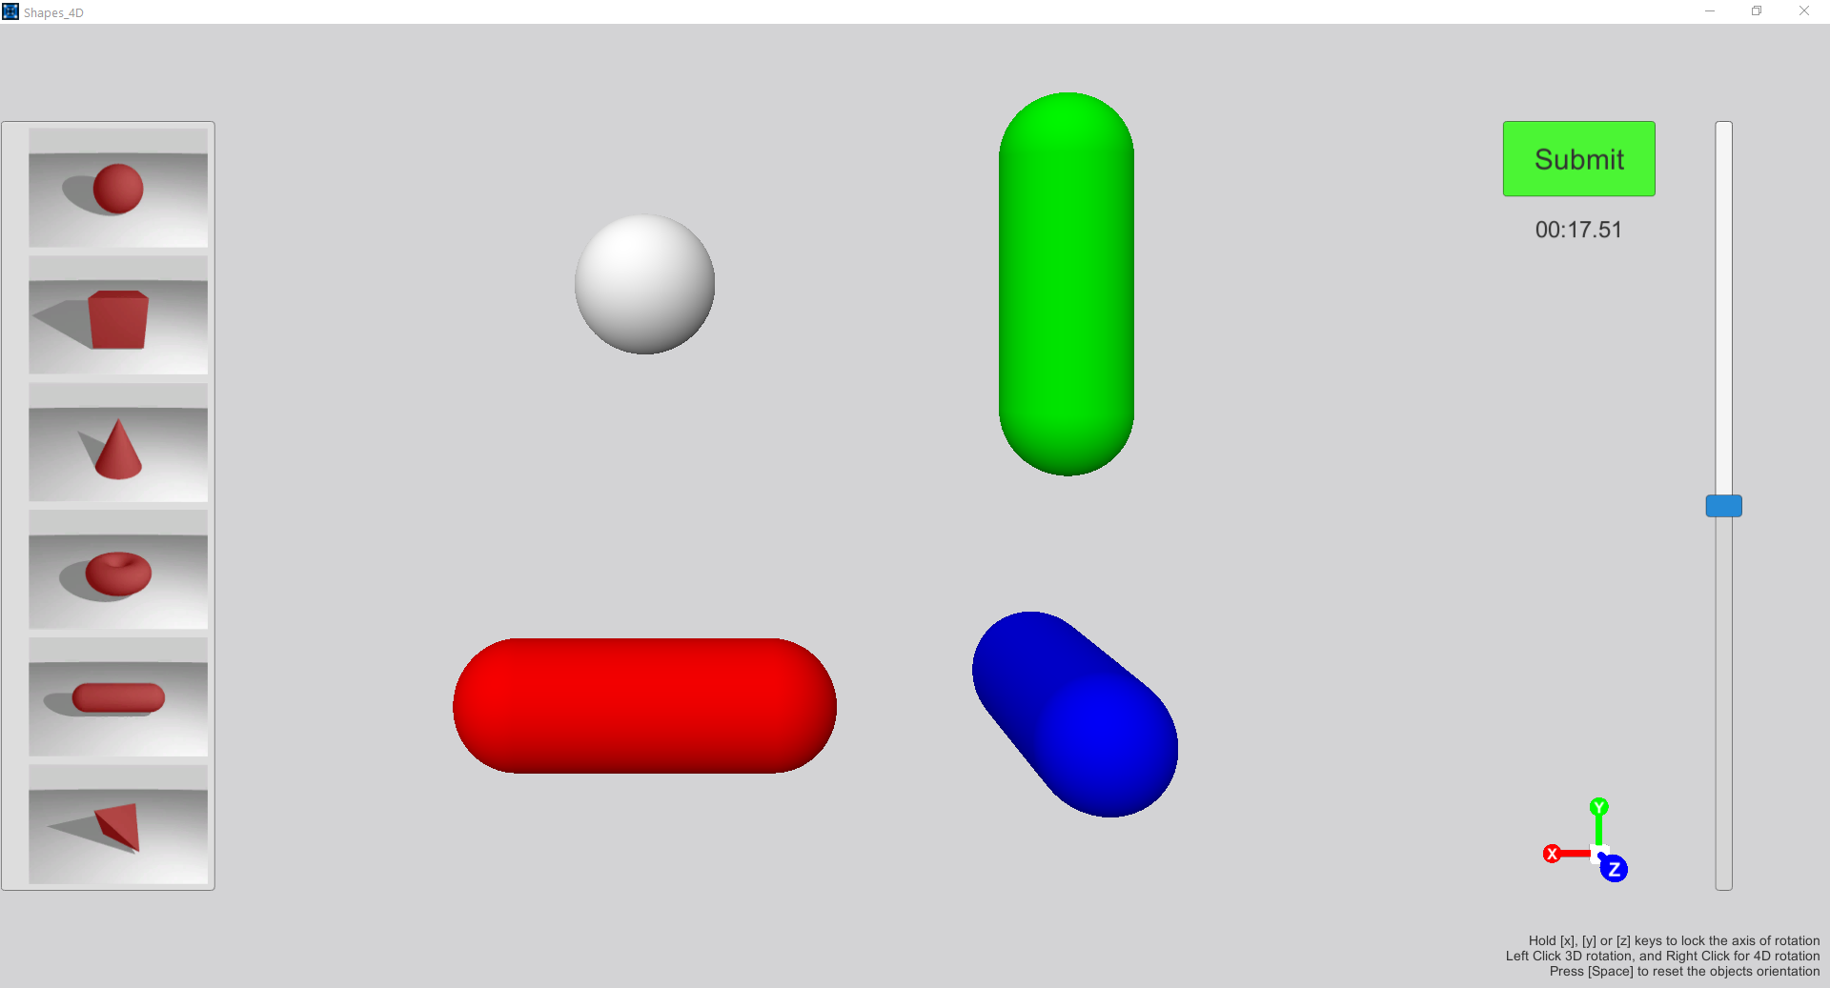
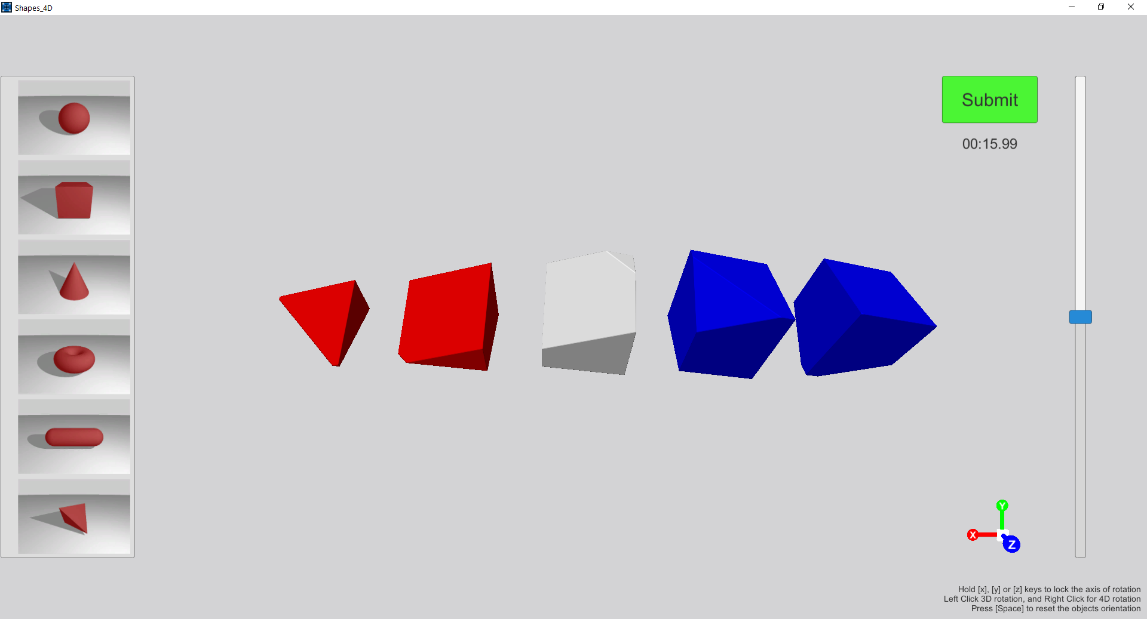
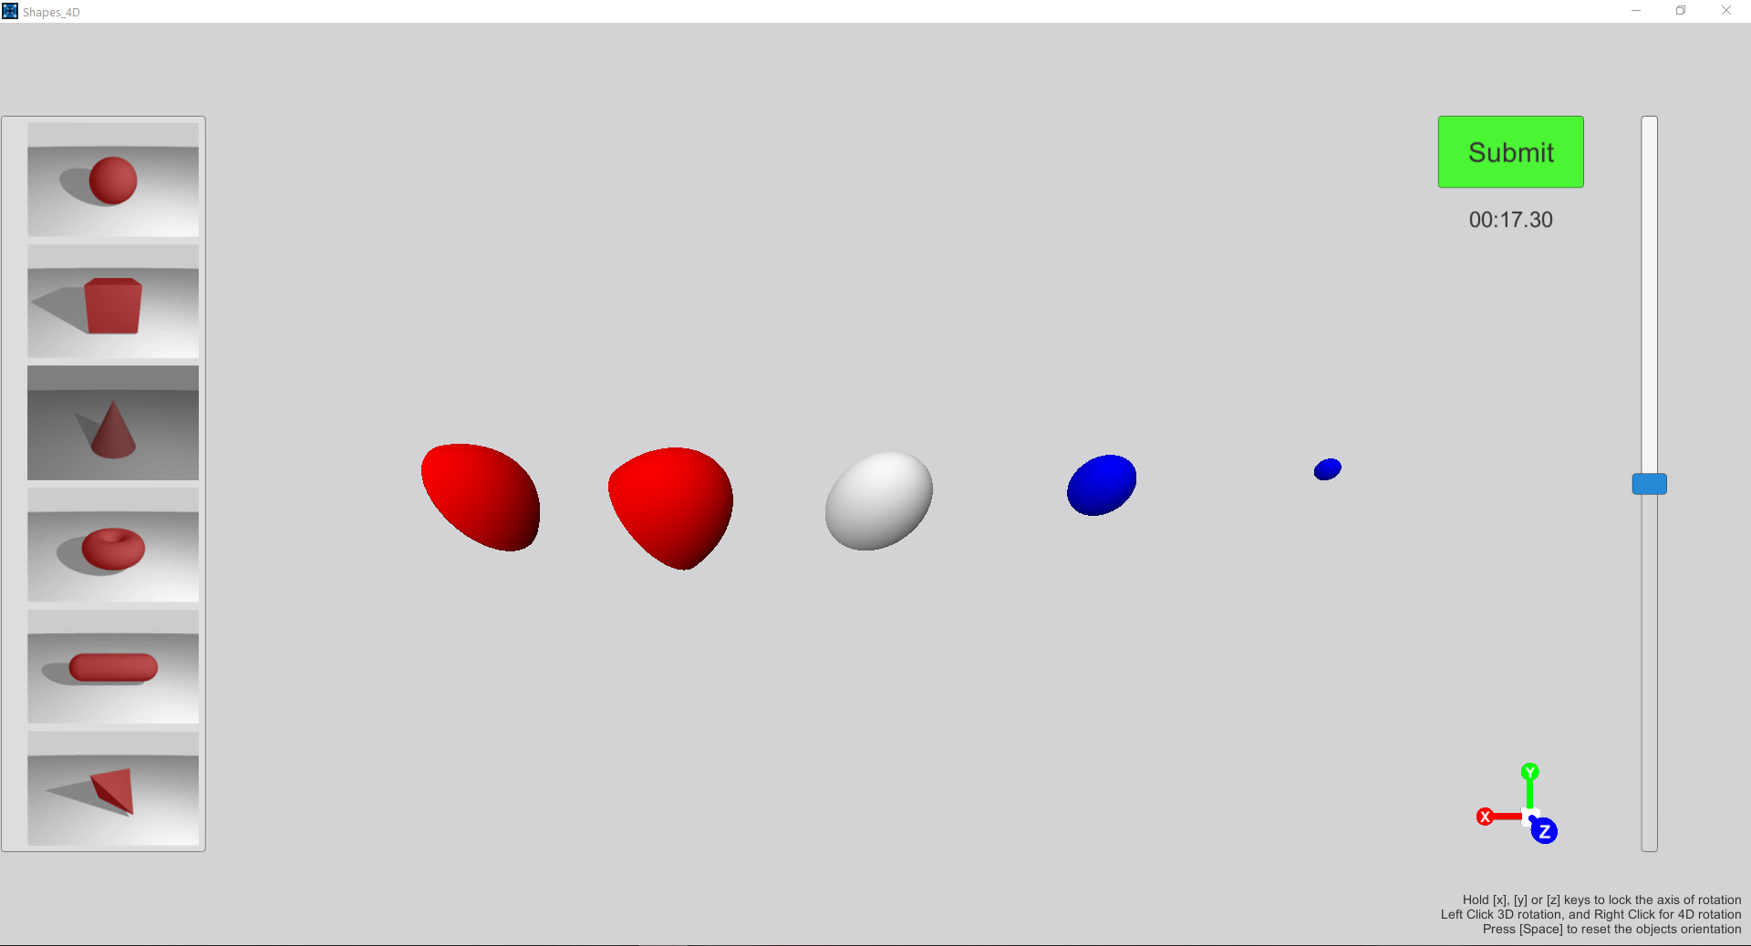
Shape Matching
The Experiment

Slide 16
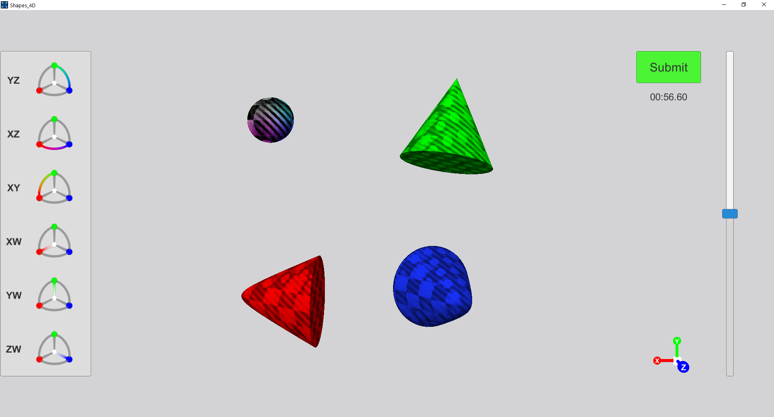
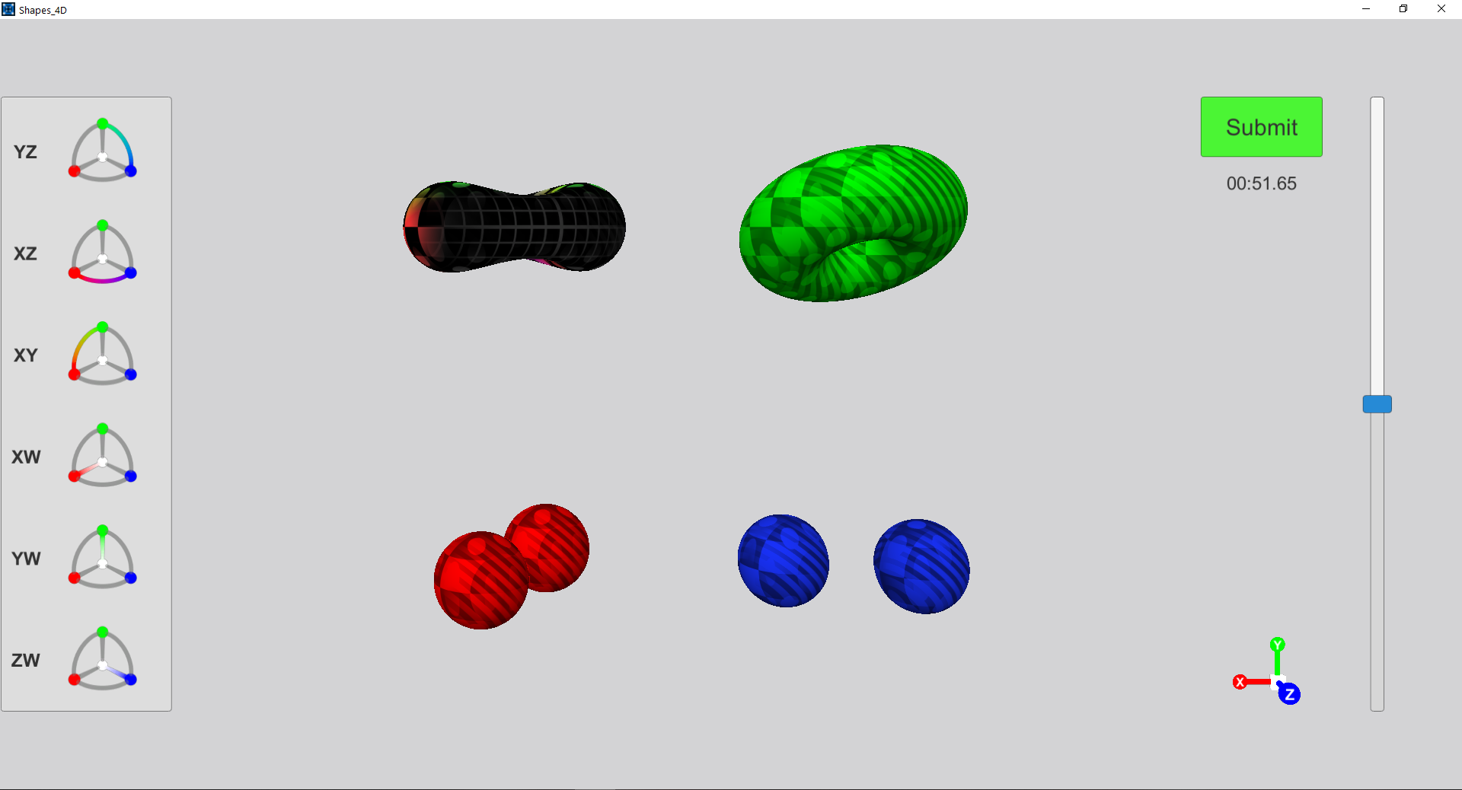
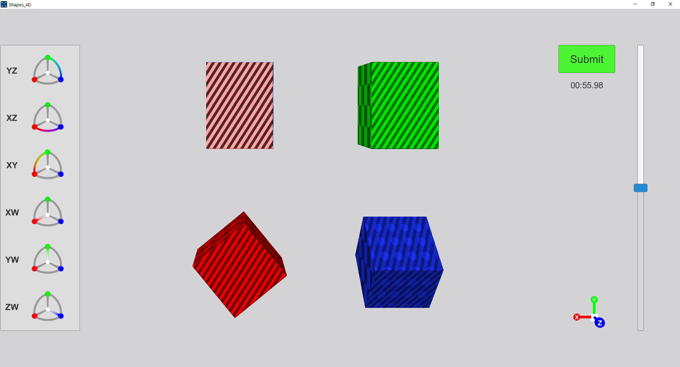
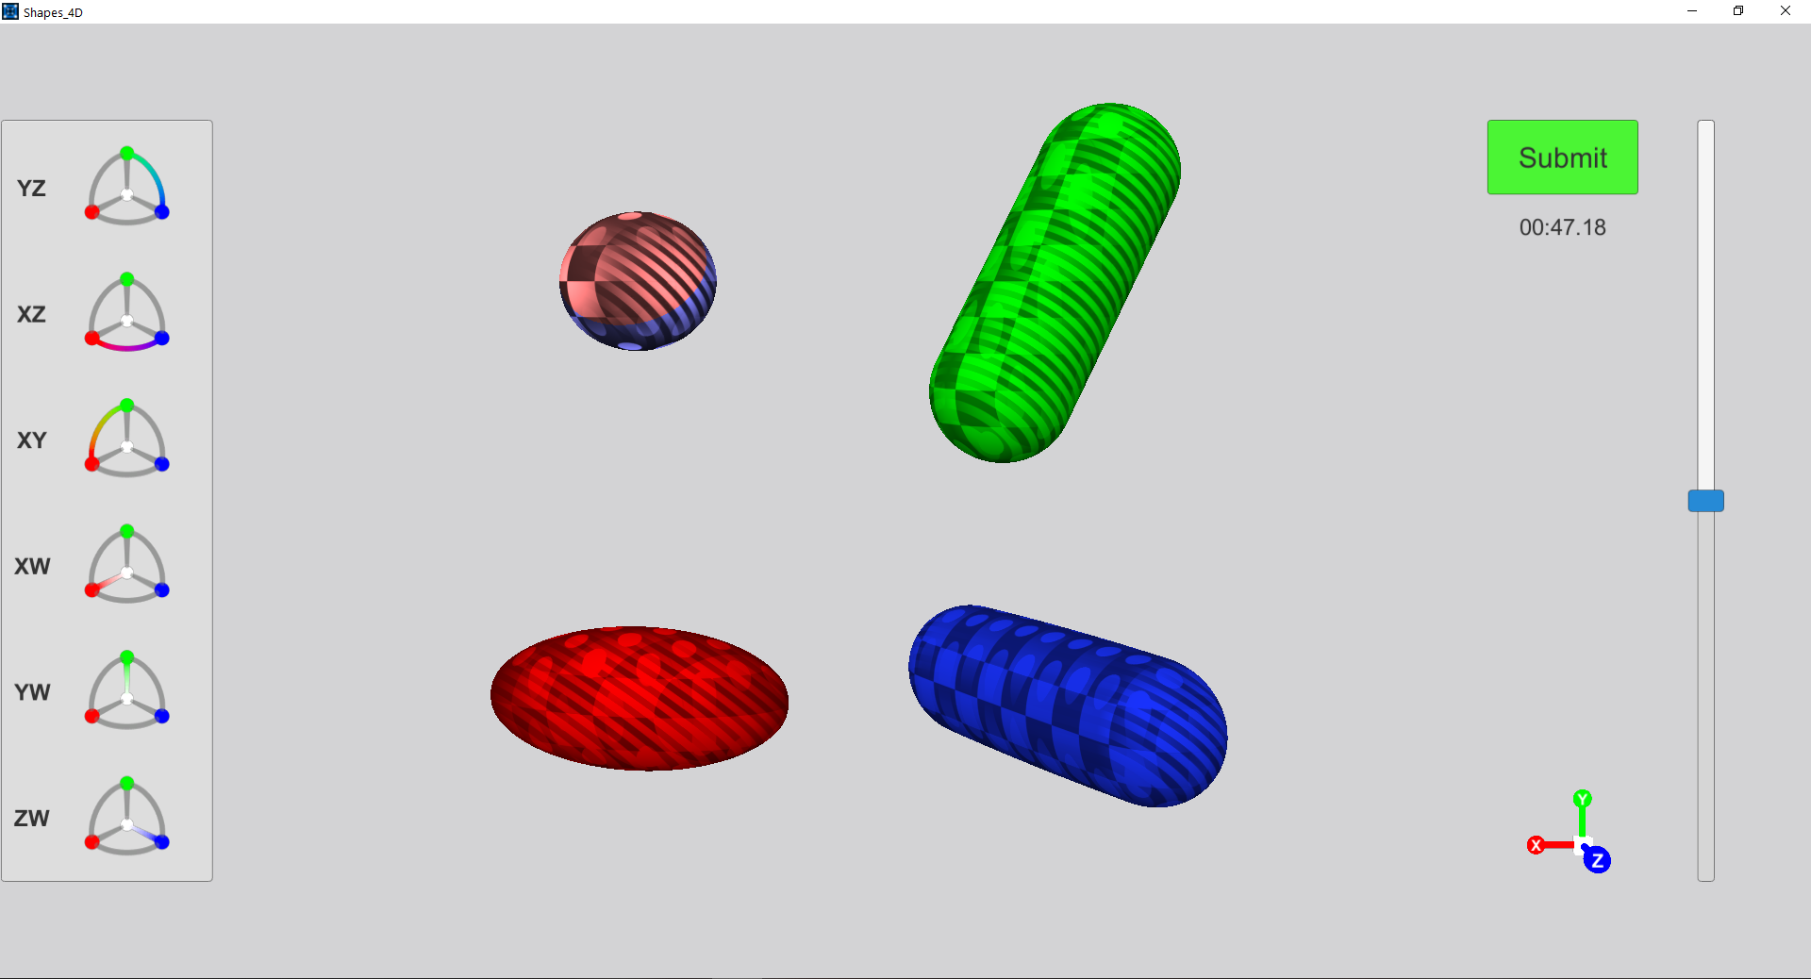
Rotation Matching
The Experiment

Slide 17
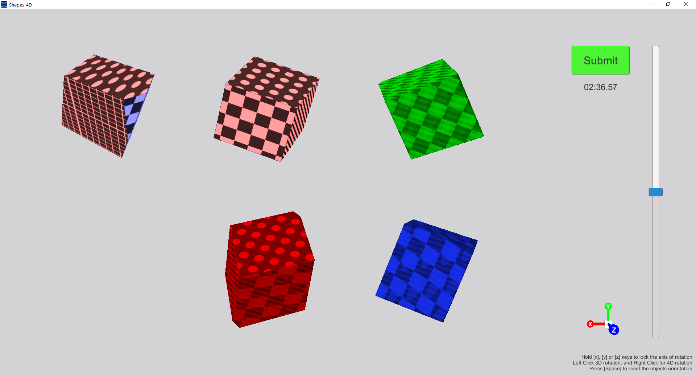
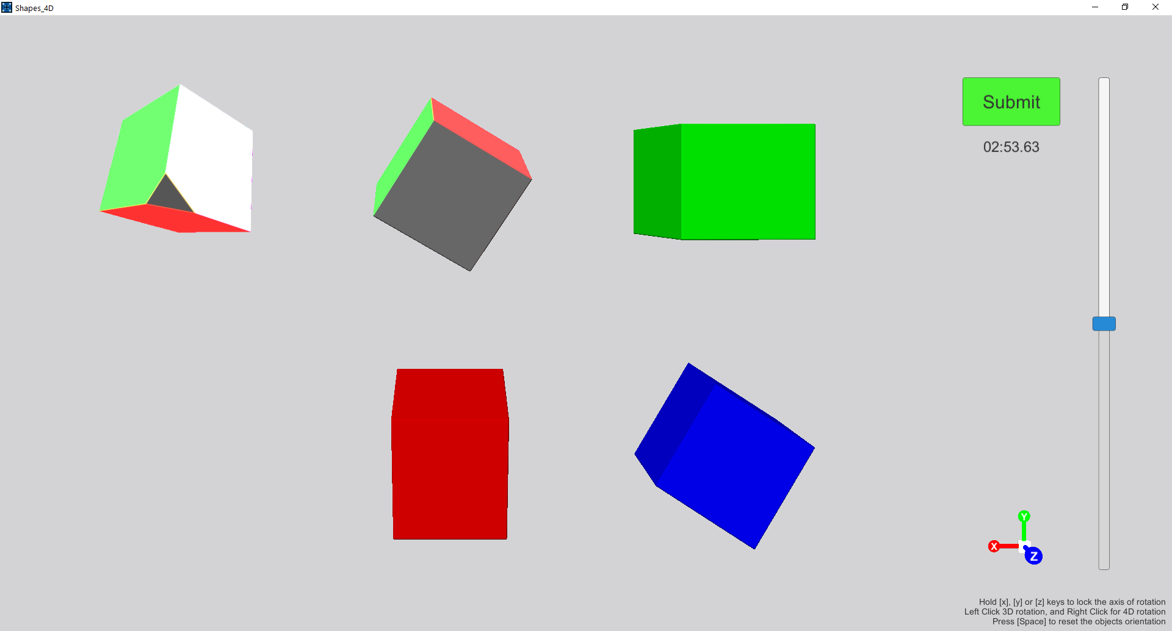
Pose Matching
The Experiment

Slide 18
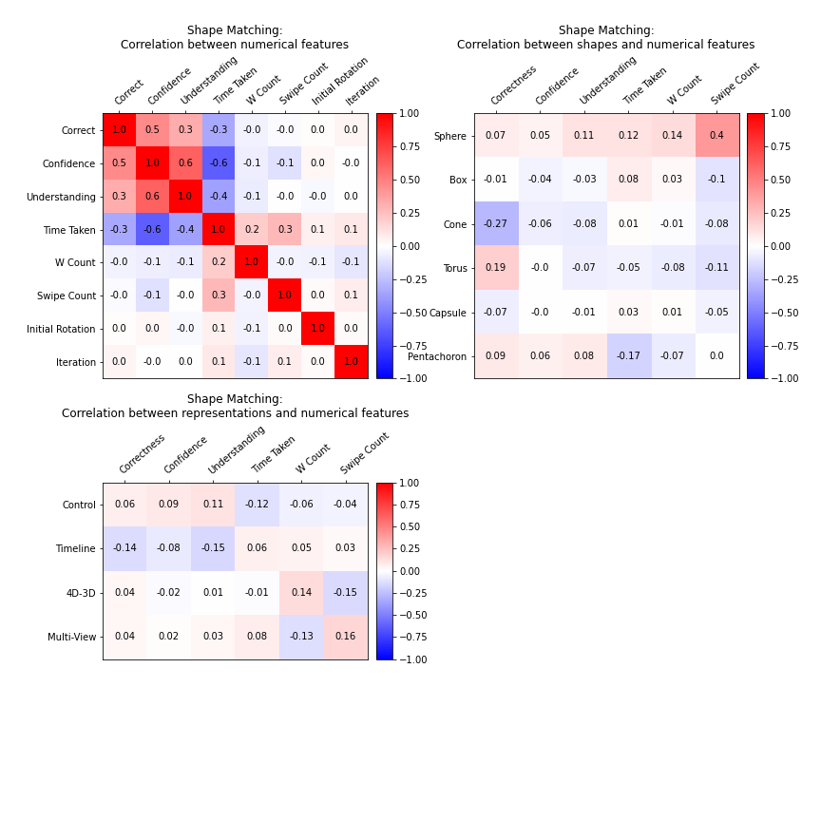
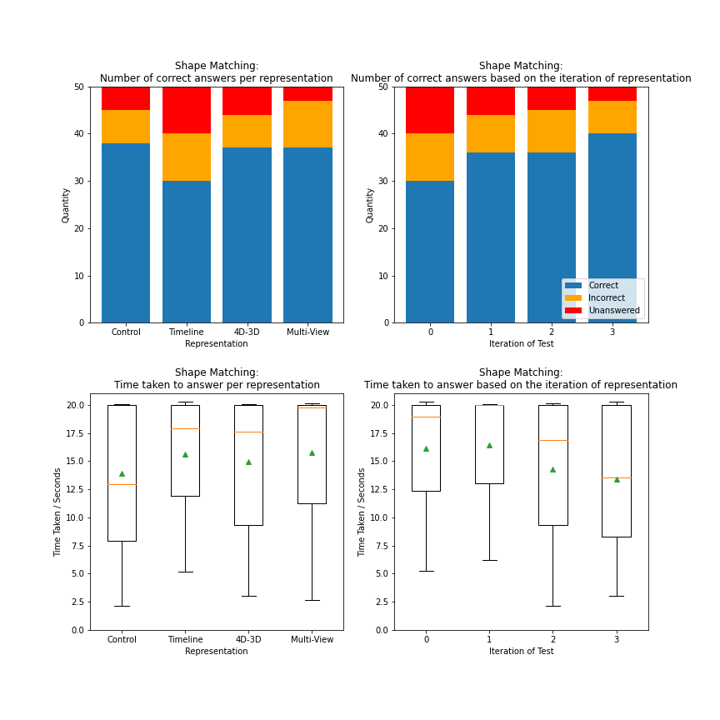
The Results
- Shape Matching

Slide 19
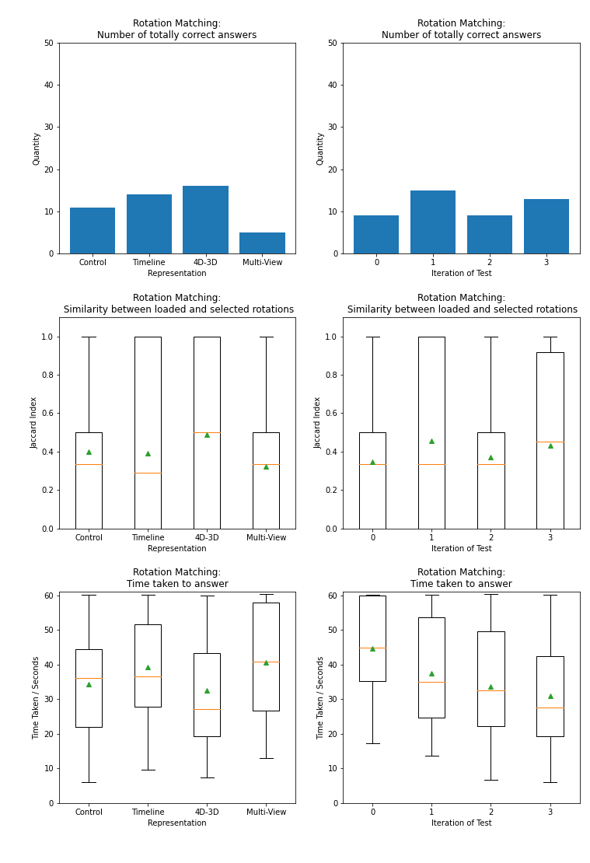
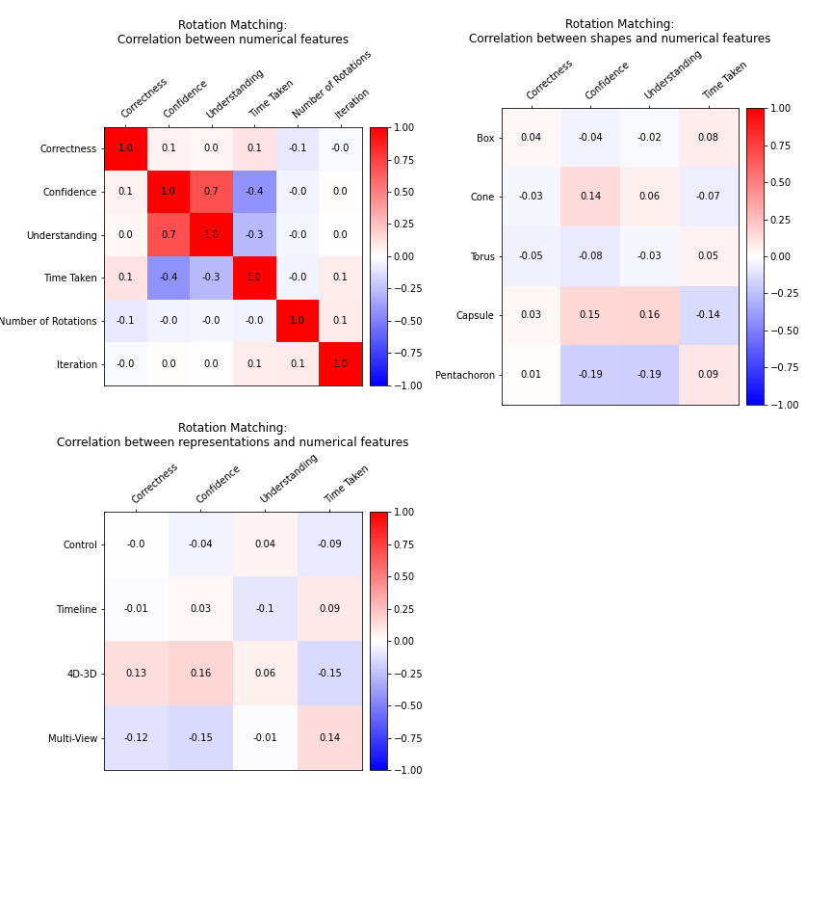
The Results
- Rotation Matching

Slide 20
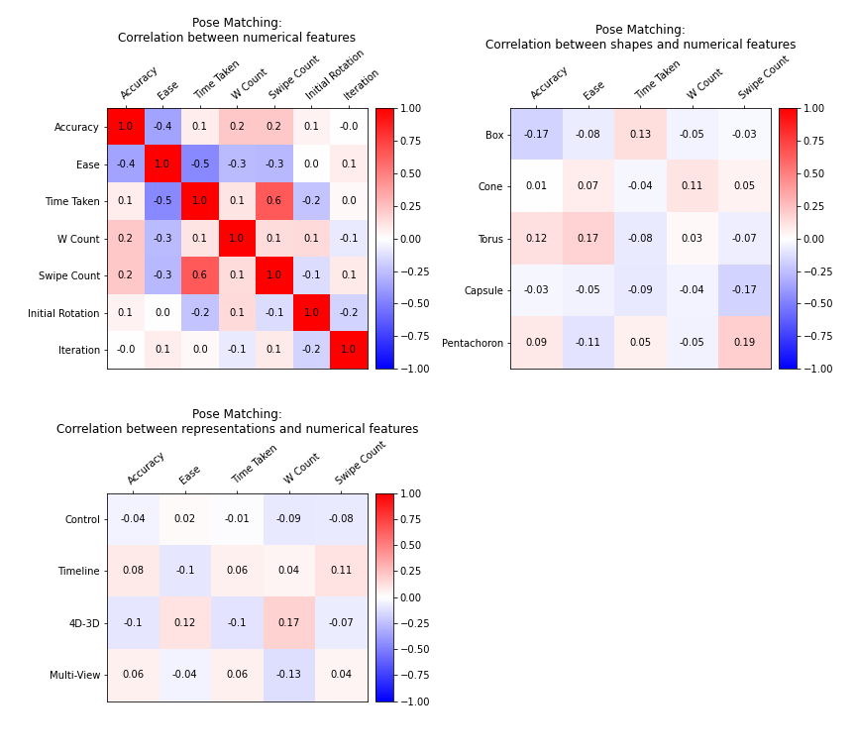
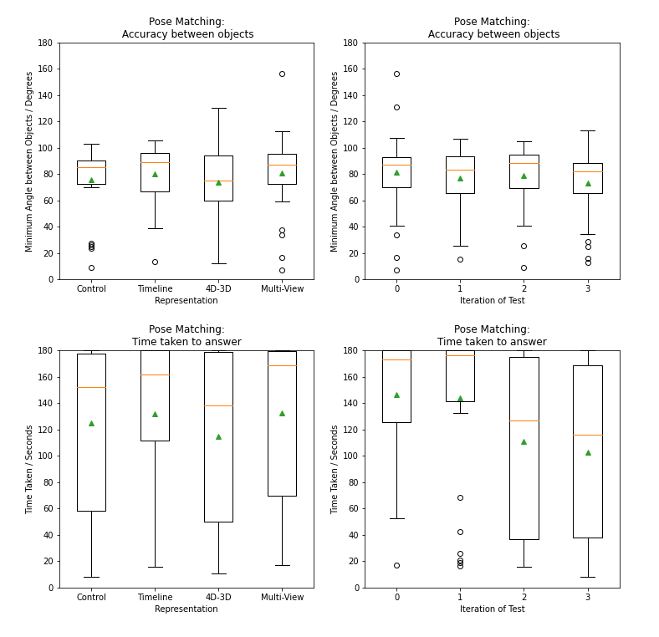
The Results
- Pose Matching

Slide 21
Conclusion

